Slide 1
Home Assignment
Tweeter Message Service

Slide 2
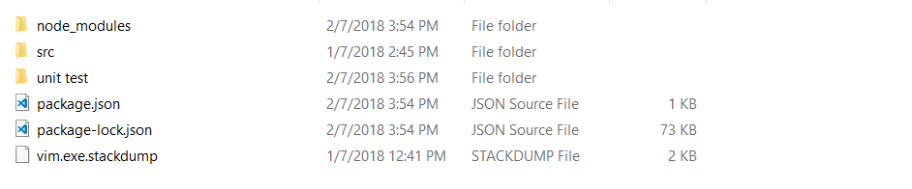
Project Directory
Main project folder
Unit test folder

Slide 3
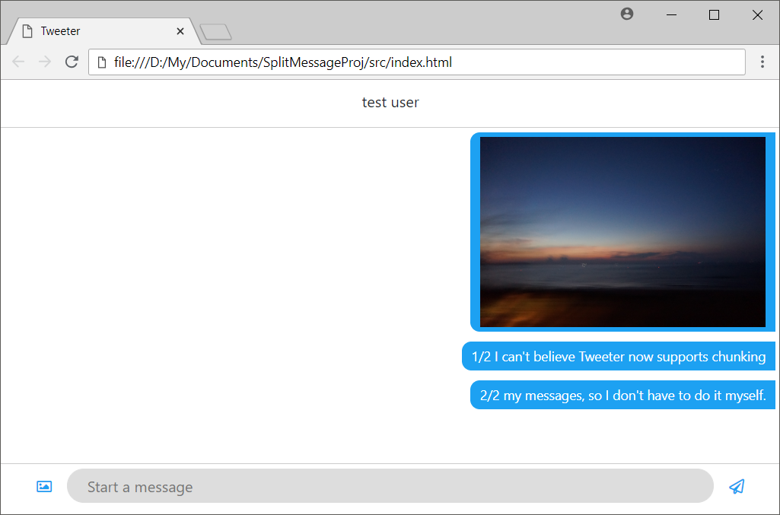
Web Application
To start the web application, navigate to “src” folder and open “index.html” in browser.
React has been used to build up some of the display content.
The splitMessage() function is written in pure Javascript and allocated in different file (src/js/prod/splitmessage.js)
Sample screenshot of the web application

Slide 4
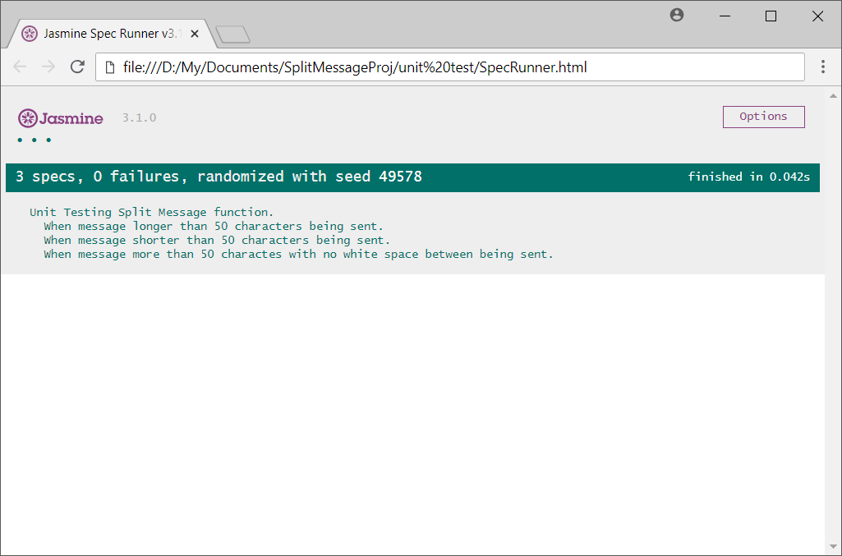
Unit Testing
Navigate to “unit test” folder and open the “SpecRunner.html” in browser.
Sample screenshot of the unit test program page

Slide 5
Thank you.

